Slide 1
Testcontainers
Integration Testing with Real Dependencies
Raúl Hernández O-Cloud Manager Team

Slide 2
Agenda
▶
The problem: integration testing with external dependencies
▶
Testcontainers: what it is and how it works
▶
Architecture: real-world example from our codebase
▶
Appendix: code walkthrough (3 steps)

Slide 3
Context
The problem
▶
Unit tests mock everything — miss real integration bugs
▶
Shared test databases create flaky, order-dependent tests
▶
CI environments differ from local — "works on my machine"
▶
Manual Docker setup for tests is brittle and not portable

Slide 4
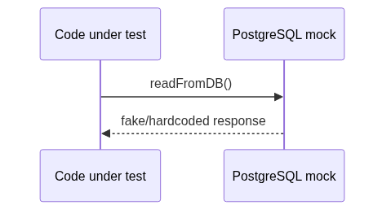
Context
How mocking works today
The mock returns canned data — no real SQL, no schema validation, no constraint checks.

Slide 5
Solution
Testcontainers
▶
Library that manages Docker containers in test code
▶
Each test gets a fresh, isolated container (DB, broker, etc.)
▶
Containers start before test, terminate after — automatic lifecycle
▶
Modules for popular services: PostgreSQL, Redis, Kafka, ...
▶
Available in Go, Java, Python, .NET, Rust, Node.js

Slide 6
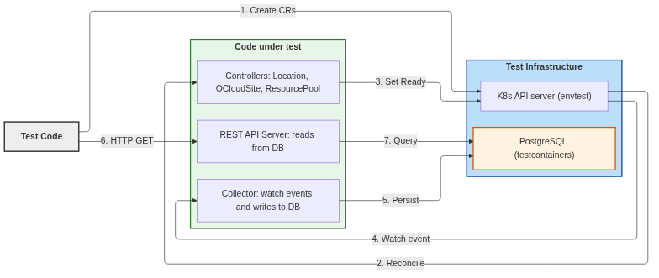
Architecture
End-to-end test architecture

Slide 7
Appendix
Step 1: Start a PostgreSQL container
pc, err := postgres.Run(ctx,
"docker.io/postgres:16-alpine",
postgres.WithDatabase("resources_test"),
postgres.WithUsername("test"),
postgres.WithPassword("test"),
testcontainers.WithWaitStrategy(
wait.ForLog("database system is ready").
WithOccurrence(2).
WithStartupTimeout(30*time.Second),
),
)
postgres is a testcontainers module — pre-configured for PostgreSQL. WaitStrategy ensures the container is fully ready before tests proceed.

Slide 8
Appendix
Step 2: Run database migrations
// Get connection string from the running container
connStr, _ := pc.ConnectionString(ctx, "sslmode=disable")
// Create connection pool — same as production code
pool, _ := pgxpool.New(ctx, connStr)
// Apply schema migrations from embedded SQL files
source, _ := iofs.New(migrationsFS, "db/migrations")
m, _ := migrate.NewWithSourceInstance("iofs", source,
migrateConnStr(connStr))
m.Up()
Same migration code used in production — guarantees schema parity. Each test run starts with a clean, correctly-migrated database.

Slide 9
Appendix
Step 3: Test and cleanup
var _ = AfterSuite(func() {
cancel() // signal collector to stop
testServer.Close() // stop HTTP server
testEnv.Stop() // stop envtest K8s API
// One call tears down the container completely
Expect(pgContainer.Terminate(ctx)).To(Succeed())
})
Terminate() stops the container and releases all resources. No leftover state between test runs — fully hermetic.
Key takeaway: real dependencies, zero maintenance, total isolation.

Slide 10
Resources
▶
testcontainers.com — official site & docs
▶
github.com/testcontainers/testcontainers-go — Go module
▶
Branch: demo.testcontainers — working example in our repo

